Slide 1



Slide 2

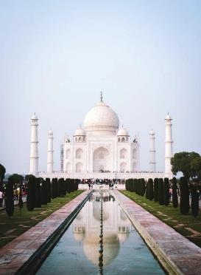
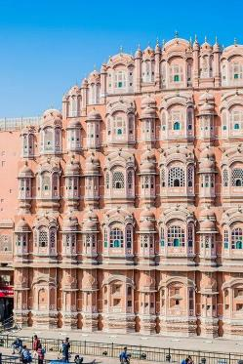
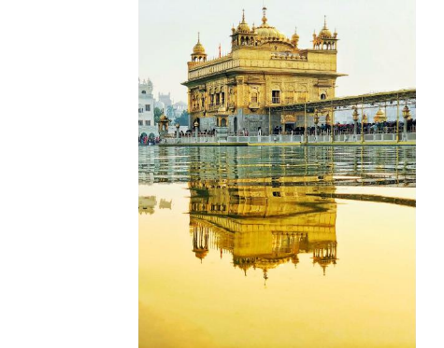
India

Slide 3

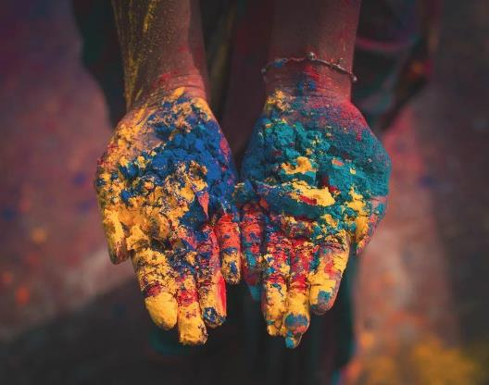


Slide 4






25 Minutes’ drive from New Delhi
90 Minutes’ Drive from
IGI Airport
30 Minutes’ Drive from upcoming Jewar International Airport
40 Minutes’ Drive from Hazrat Nizamuddin Railway Station
A city very
well NCR
Metro
connected with
Delhi through Network

Slide 5
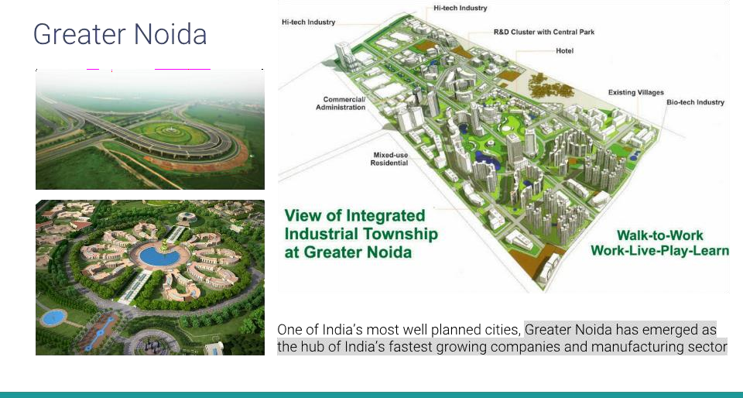

Slide 6
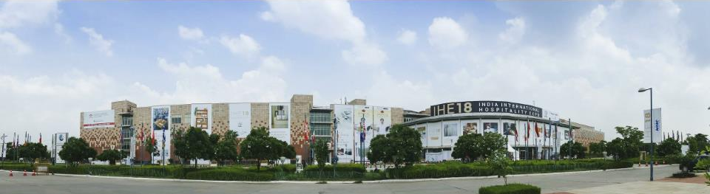
Established in 2006, India Expo Centre and Mart is spread over 58 acres and is India’s largest integrated venue for exhibitions, conventions and conferences
India Expo Centre and Mart

Slide 7
India Expo Centre and Mart

Slide 8

India Expo Centre and Mart, Greater Noida / Running Exhibition Venue
●
●
●
●
●
●
●
●
●
●
●
12 Directors on board
Rs.100 Crores with paid-up capital of Rs. 37 Crores.

Slide 9

India Expo Centre and Mart, Greater Noida / Running Exhibition Venue
250+ (Last five years)

Slide 10
India Expo Centre and Mart

Slide 11
India Expo Centre and Mart, Greater Noida / Secure Venue
Compliances and Licenses
●
●
○
○
○
○
●
●
●
●
●
●
●
●
●
●
●
Insurances at India Expo Centre and Mart
●
●
●
●
●
●
●

Slide 12

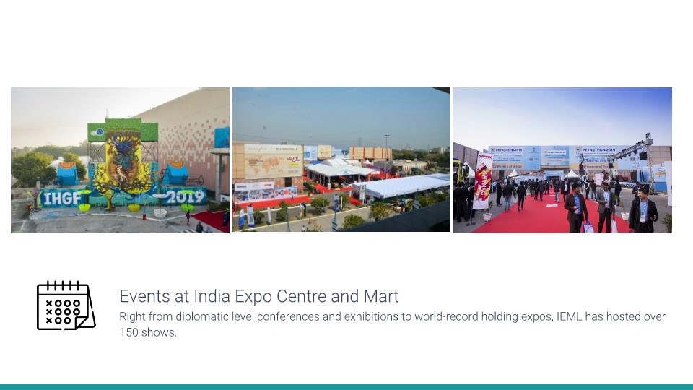
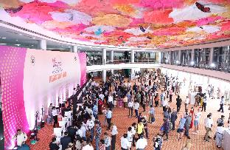
Right from diplomatic level conference and exhibitions to world-record holding expos, IEML has hosted over 250 shows.

Slide 13
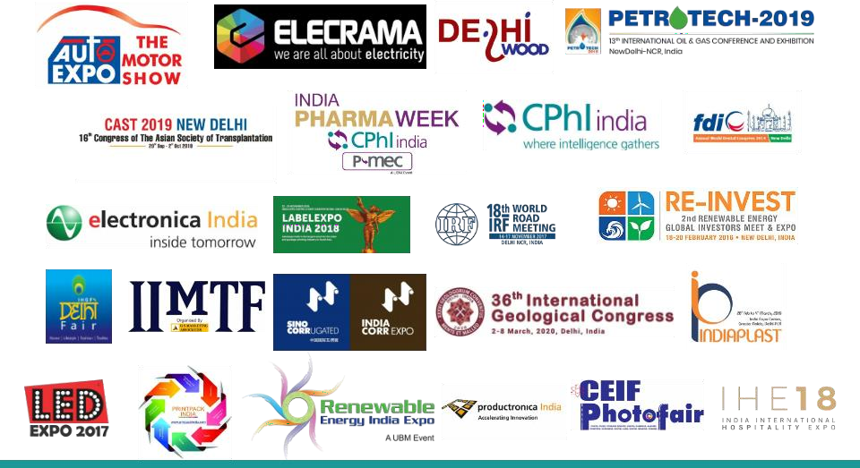














Slide 14


















Our Own & Managed Shows

Slide 15

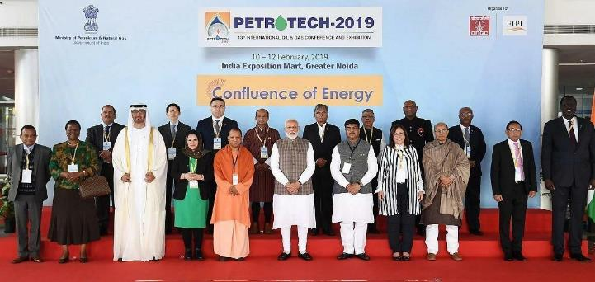


Slide 16

Mega Shows at IEML Of Individual Segment
Event Name | Organiser
Indian Handicrafts and Gifts Fair (2006-2027) | EPCH
Auto Expo (2014,2016,2018,2020, 2023) | SIAM
CPHI & P-MEC (2018-2025) | Informa Markets Pvt. Ltd.
Elecrama (2018,2020, 2023, 2025) | Indian Electrical and Electronics Manufacfturers Association (IEEMA)
India ITME (2022, 2026) | ITME Society
Bauma Conexpo (2014, 2023, 2024) | Messe München
Electronica Productronica and Semicon Expo (2019, 2022, 2024) | Messe München
Paperex (2022, 2023) | Hyve India Pvt Ltd
Print Pack India (2013,2015,2017,2019,2022,2025) | Indian Printing Packaging and Allied Machinery Manufacturers' Association (IPAMA)
IndiaCorr Expo (2017,2019,2021,2023, 2025) | Reed Exhibitions India
Delhi Wood (2015, 2017, 2019, 2023, 2025) | NürnbergMesse India Pvt. Ltd.
Label Expo (2016, 2018, 2022,2024) | Tarsus Group
SATTE (2019,2020, 2021,2022,2023,2024) | Informa Markets Pvt. Ltd.
Renewable Energy India (2013,2015,2016,2018,2019,2021,2022-2025) | Informa Markets Pvt. Ltd.

Slide 17

International & World Congresses at IEML
Conference Name | Organiser
46th Annual General Meeting of Board of Governors Asian Development Bank (ADB) - 2013 | Ministry Of Finance & Asian Development Bank
International Petro Tech Conference (2014,2019) | ONGC
6th Regional Comprehensive Economic Partnership (RCEP), 2014 | Min of Commerce
UNCCD-COP 14 | Ministry of Environment, Forest & Climate Change
Seventh Session of the Conferences of Parties (COP7) 2017 | Ministry of Health & Family Welfare, Govt. of India,
International Geological Congress 2020 (IGC) 2020 | Ministry of Earth Science, Govt. of India
18th World Road Meet 2017 | IRF
19th World Organic Congress 2017 | PDA Trade Fair
Delhi International Renewable Energy Congress 2010 | Govt of India
PAN IIT 2010 | Asssociation of IIT Allumuni
47th Annual Conference on Indian Acadamy of Pediatrics 2010 | APICON
12th Triennial Congress of the International Federation of Societies for Surgery of the Hand | International Federation Of Societies For Surgery Of The Hand (IFSSH)
102nd FDI Annual World Dental Congress 2014 | Indian dental Assosiation(IDA)
22nd IFFS World Congress 2016 | Creative Travel
PEDICON 2022 | PEDICON SOCIETY
India Water Week 2022 | Min of Jalshakti
World Dairy Summit 2022 | National Dairy Development Board

Slide 18

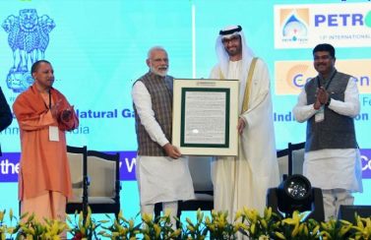
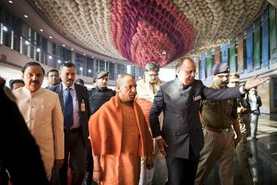
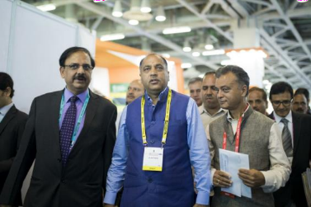
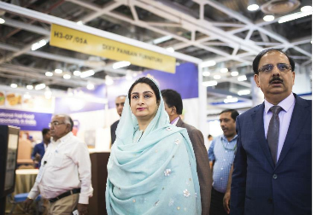

Slide 19
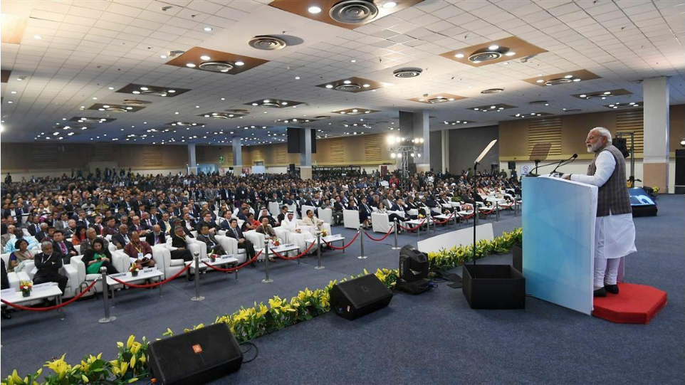

Slide 20
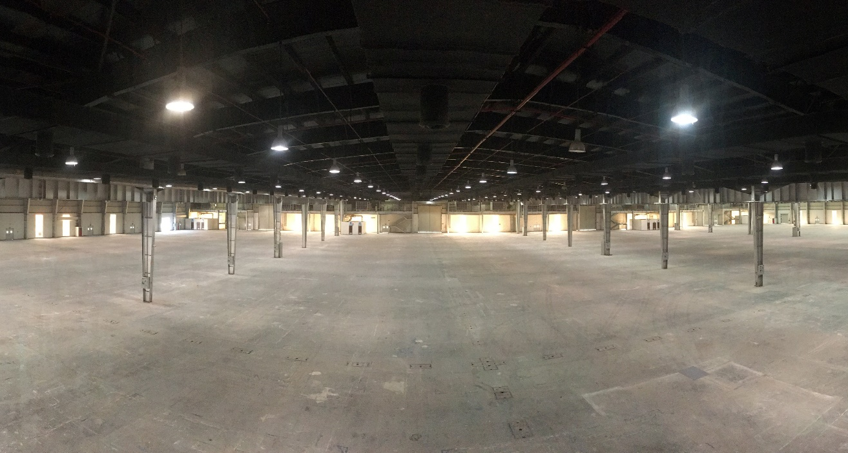
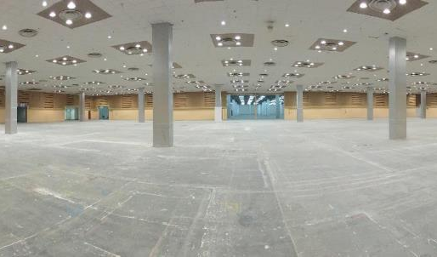
Multipurpose Exhibition Halls

Slide 21
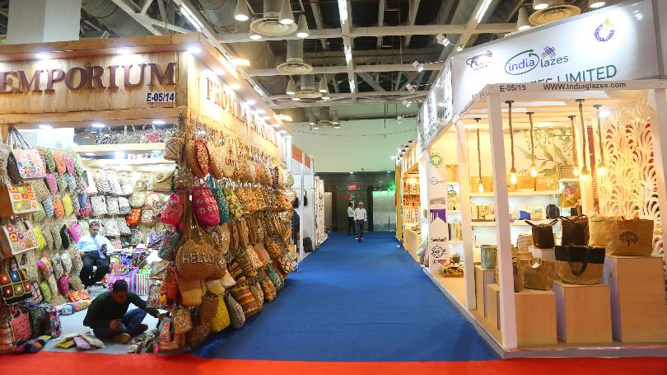
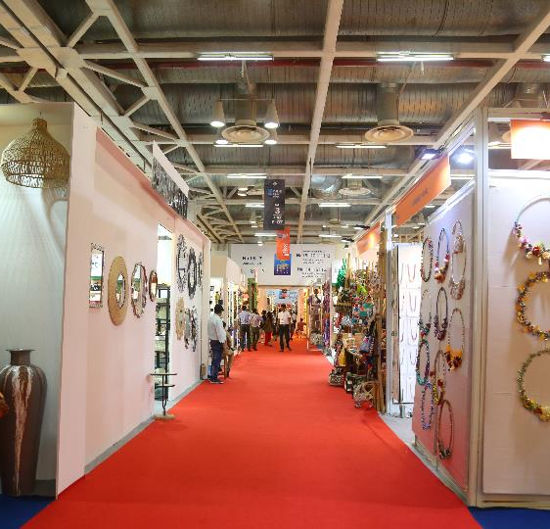

Slide 22
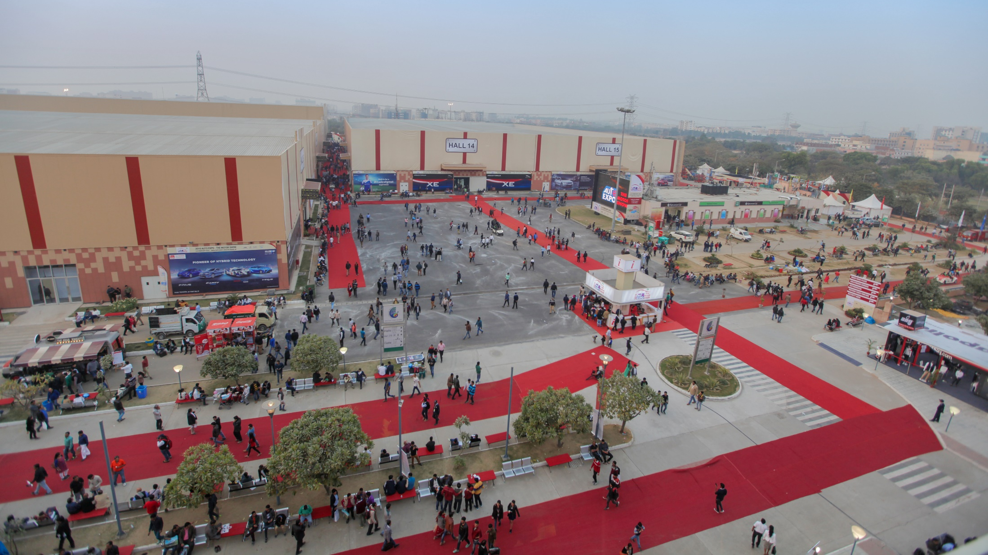
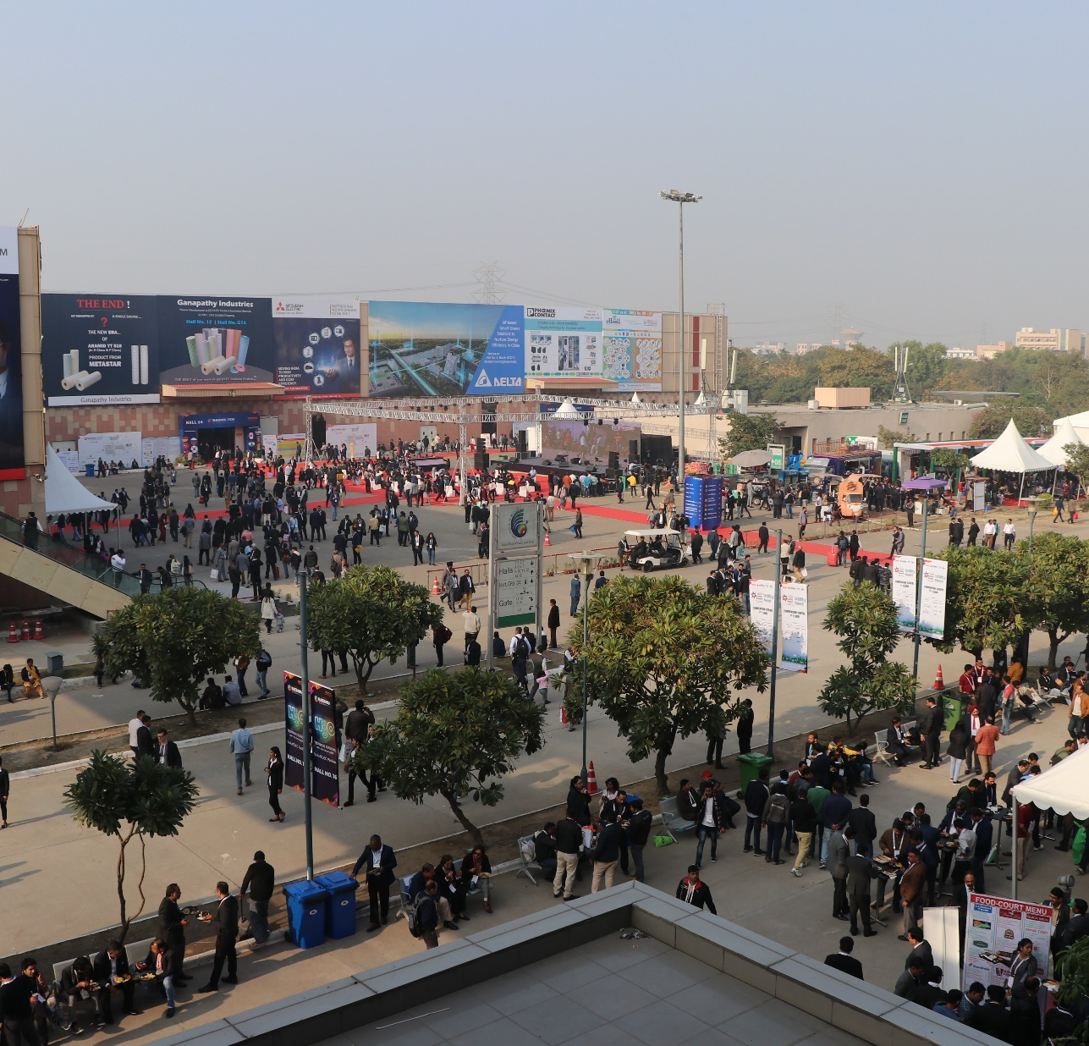
Huge Open Area for Hangar Structure

Slide 23
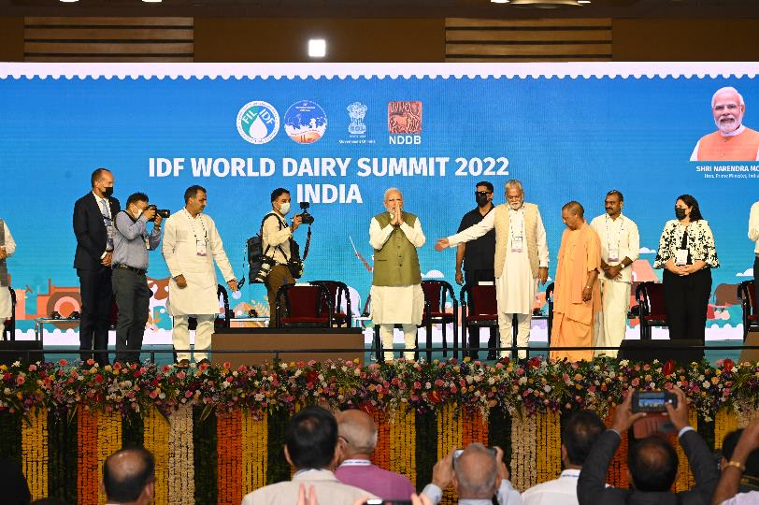

Slide 24
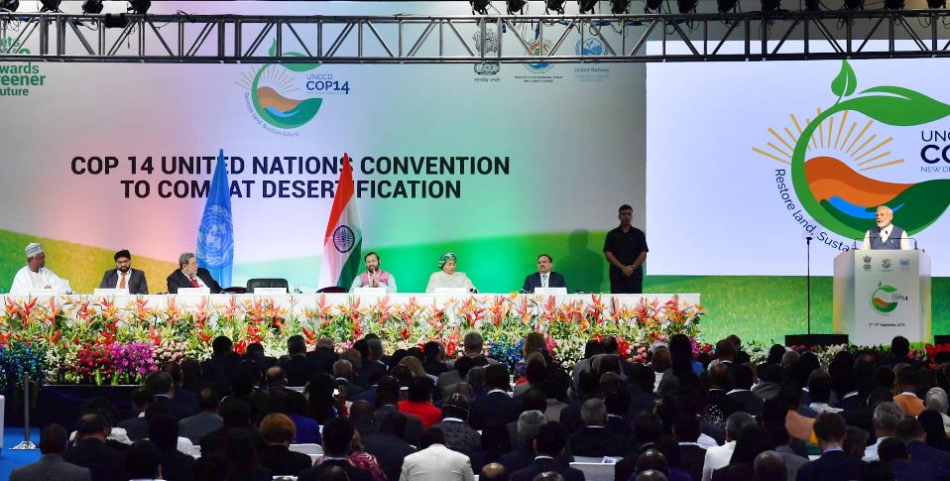

Slide 25
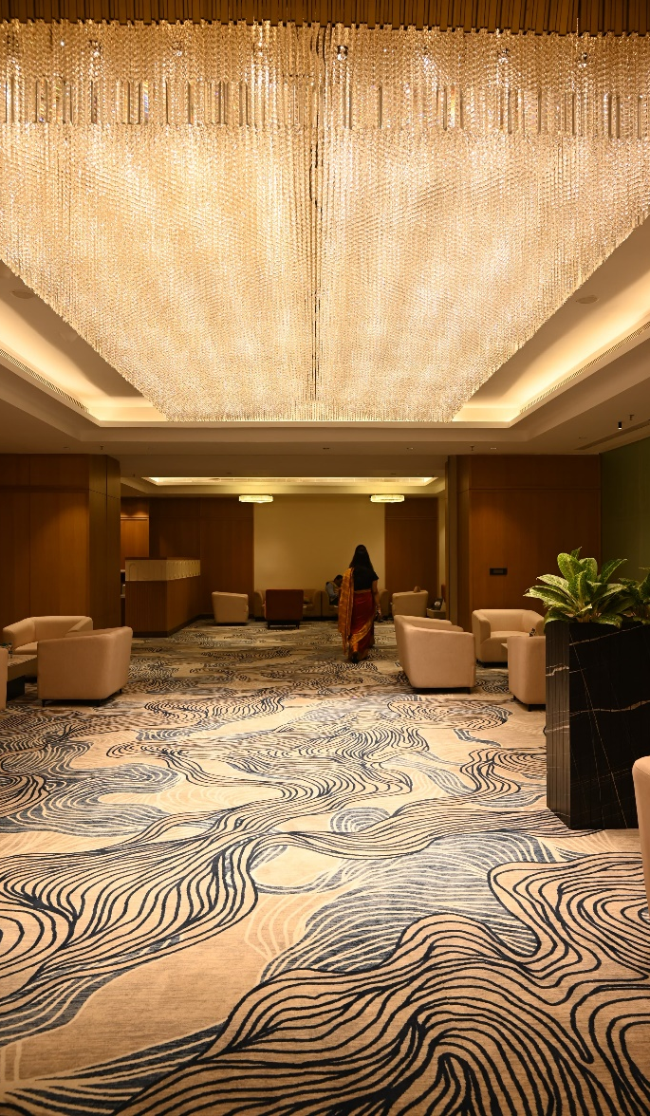
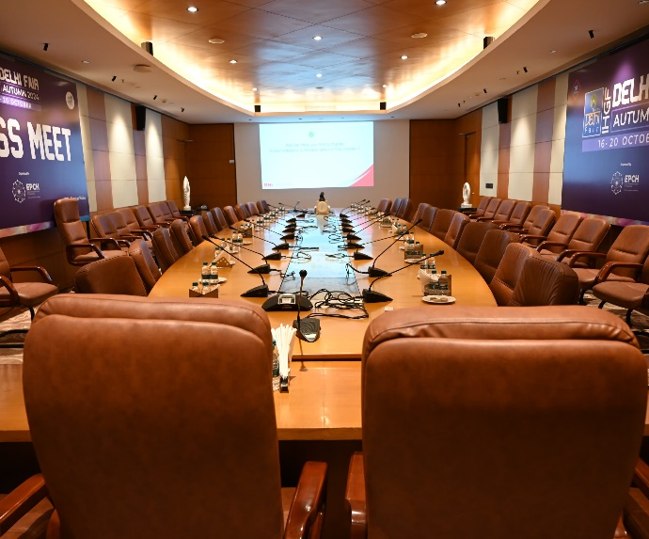
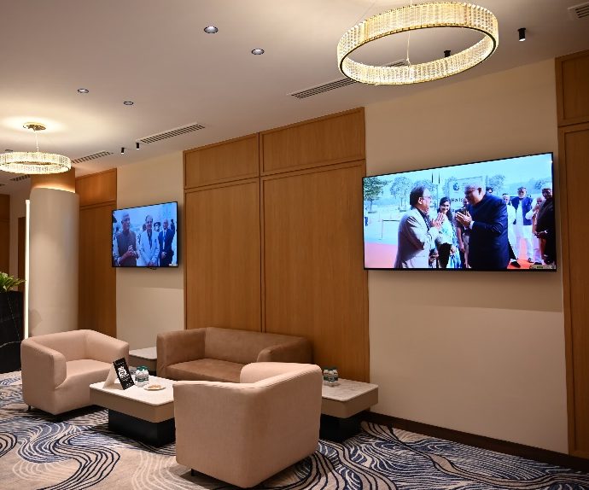
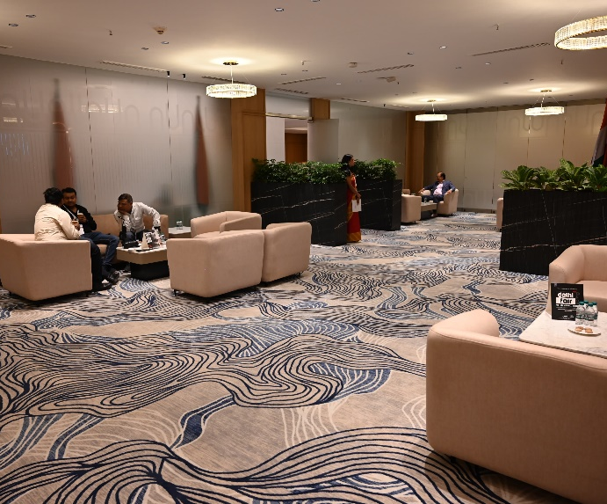
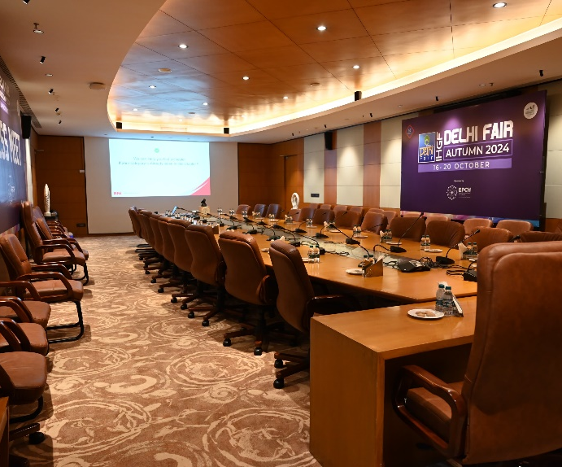
Boardroom and Lounges

Slide 26

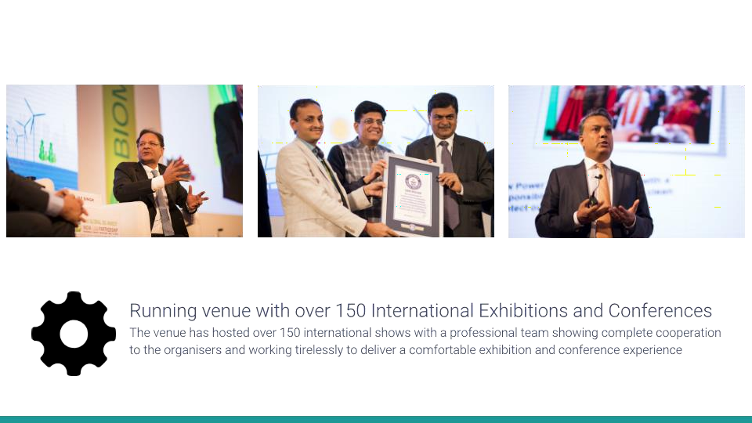

Slide 27
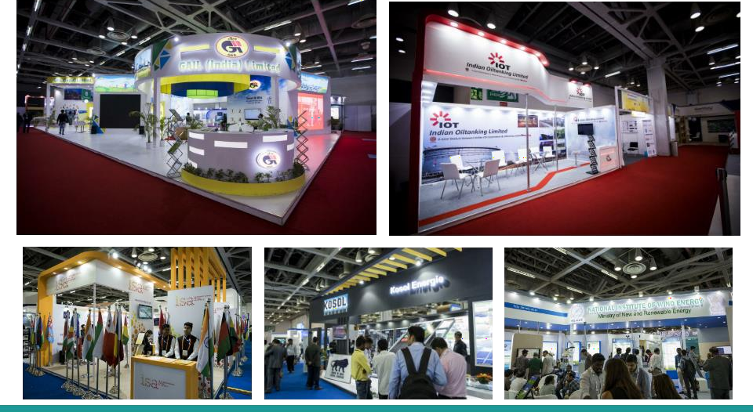

Slide 28
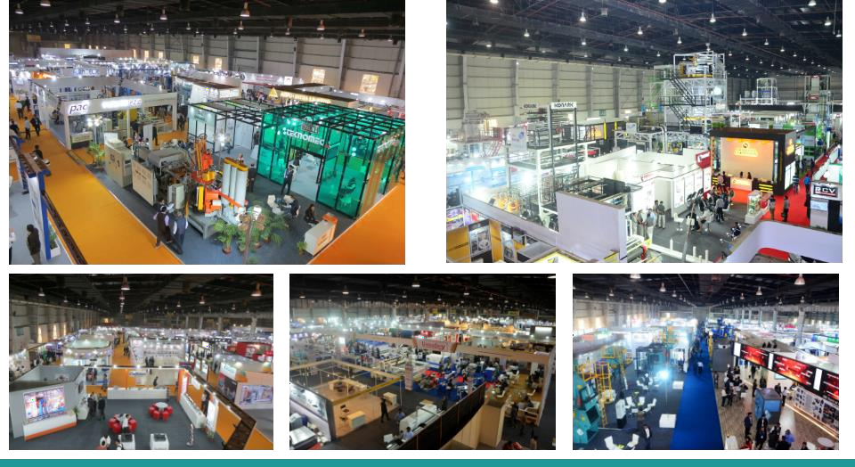

Slide 29
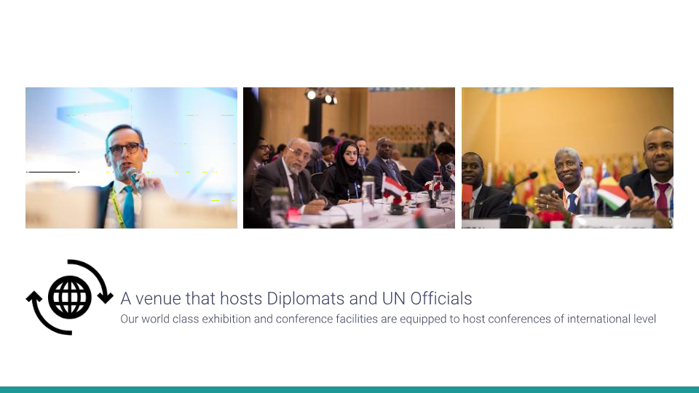


Slide 30
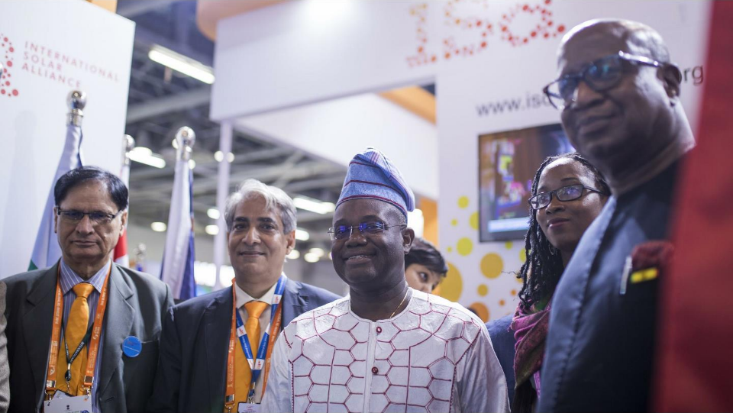

Slide 31
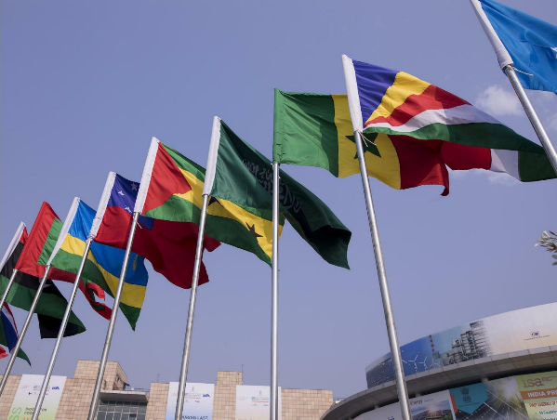
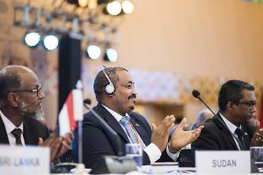
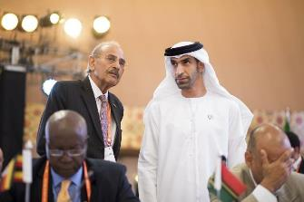

Slide 32

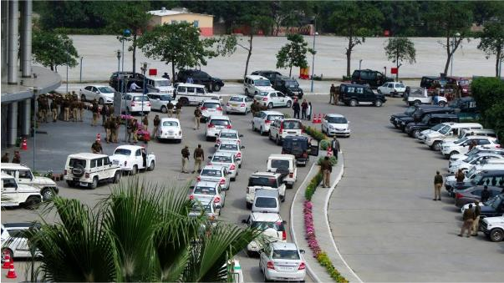
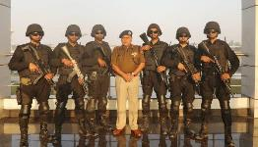
Police escort for each official
delegation and VVIPs

Slide 33
Licenses and Insurances

Slide 34
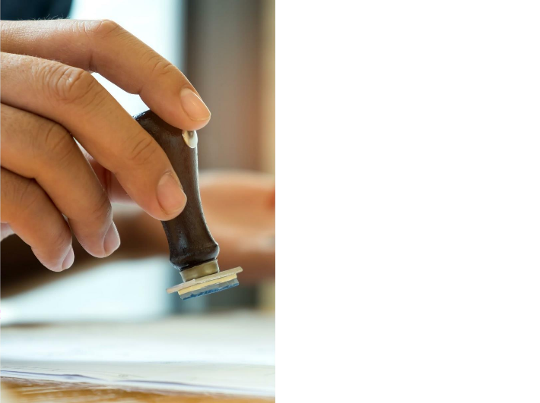

100% Compliance and Licenses
●
●
●
●
●
●
●

Slide 35
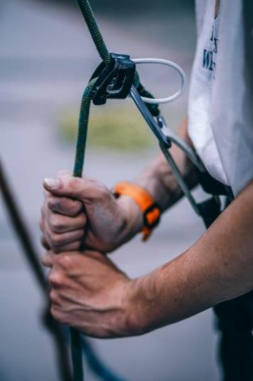

Insurances at India Expo Centre and
Mart
●
●
●
●
●
●
●

Slide 36
India Expo Centre and Mart

Slide 37
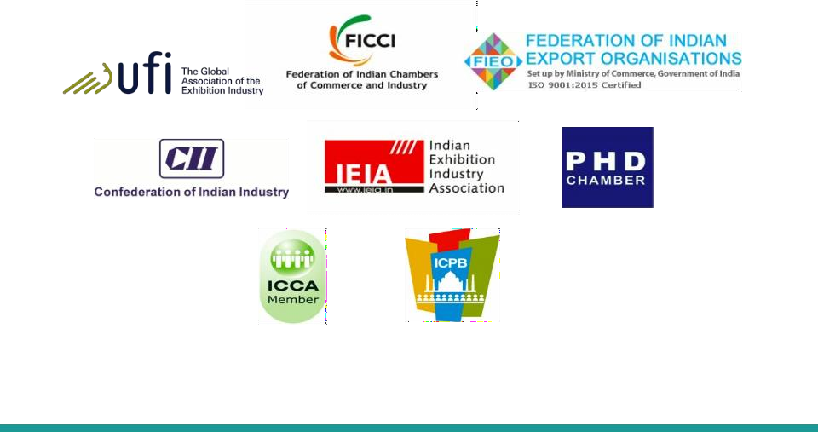
International Congress and
Convention Association
India Convention Promotion Bureau

Slide 38

India Expo Centre and Mart

Slide 39
Exhibition Infrastructural Facilities
●
●
●
●
●
●
●
●
●
●
●
●
●
●
●
●
●
●
●
●
●
●
●
●
●
Expo inn suits with 134 rooms

Slide 40
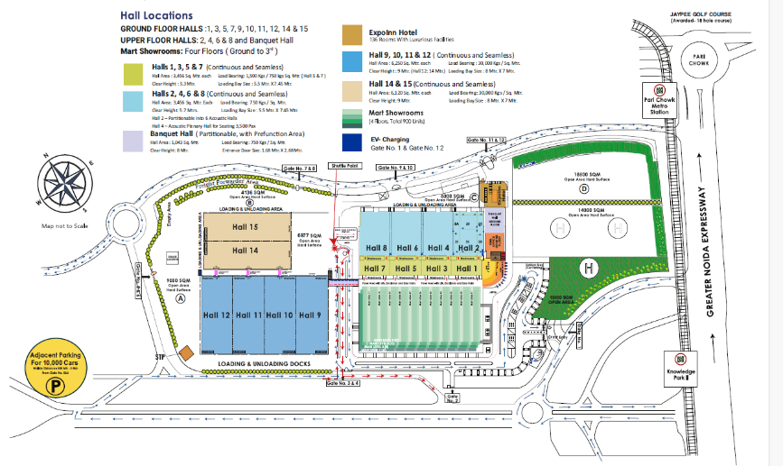

Slide 41

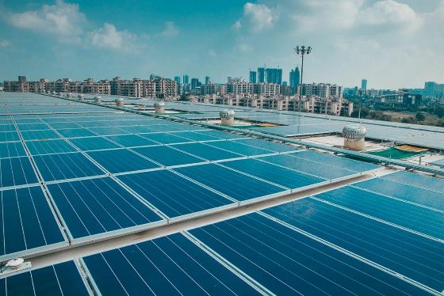

In-house uninterrupted power supply
of 34 MW + 3 MW Solar Power

Slide 42


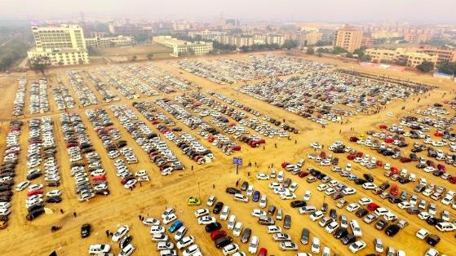
In-house car parking for over 2,000 cars plus additional car parking for 10,000 cars available in the surroundings

Slide 43
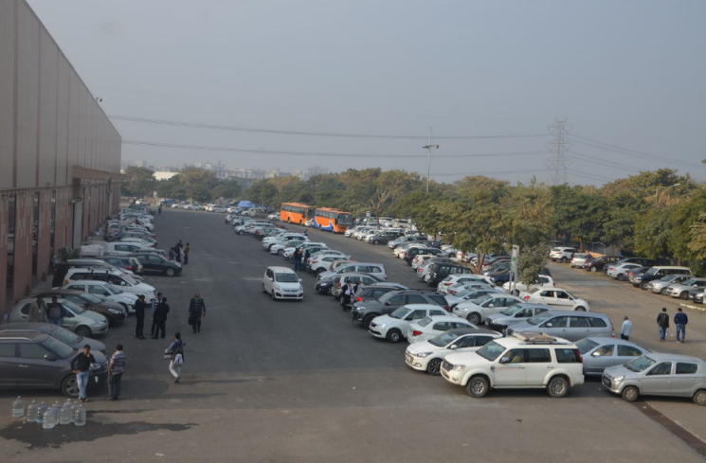
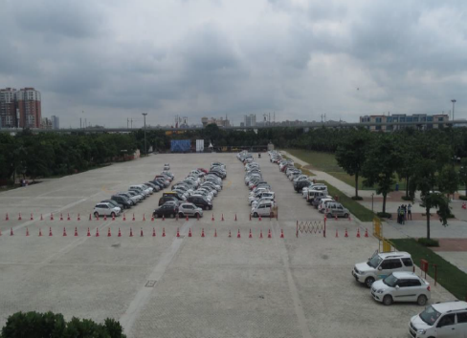
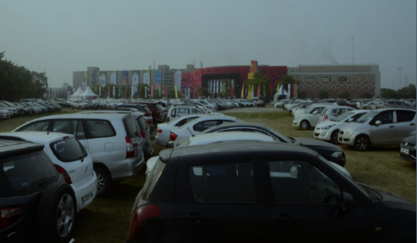
Inhouse 3000 Parking Space
And Additional Parking of 10,000 Vehicles adjacent to venue

Slide 44

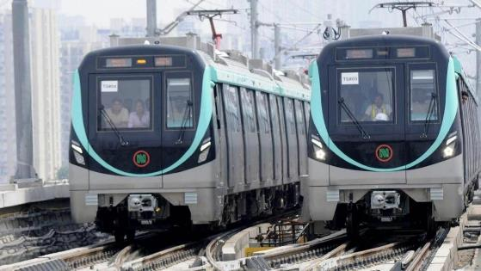

Knowledge Park II Metro Station at the
venue-doorstep

Slide 45



1,400 hotel rooms within 5 square kilometers of IEML and over 6,000 rooms within 40 minutes from the venue

Slide 46
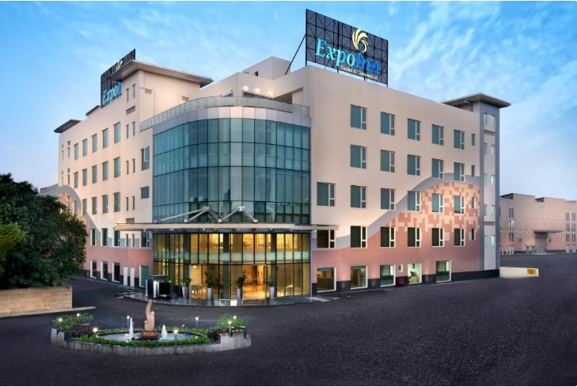
Inhouse “Expo Inn Suits & Convention” with 134 Rooms

Slide 47



Slide 48

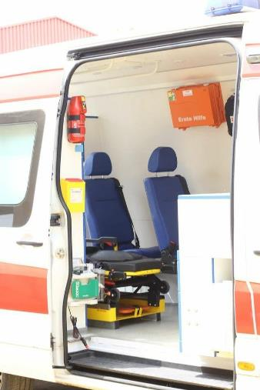




Ambulance and doctors available at
the venue, 24X7

Slide 49



Squeaky clean toilets for males, females and specially abled and professional housekeeping

Slide 50




Banking and Foreign Exchange
Services
●
●
●
●
●

Slide 51



Slide 52

Awards and Accolades by Indian Expo Centre and Mart
Awarded the National Tourism Award – Best Standalone Convention Centre in India 2017-18 & 2018 -19 by Ministry of Tourism, Government of India
Winner in “The Grand Venue” Category 2022 by Exhibition Excellence Award
The Leading Exhibition Venue of the Year 2019, 2020 & 2022 Exhibition Excellence Award
Winner for “Big Venue” Category – Exhibition Excellence Award 2017 by Exhibition Showcase
Awarded Best Exhibition Centre by Safari India 2016, by South Asia Travel
Best MICE venue of India by TravTour MICE Guide, 2018

Slide 53


Reward & Recognitions

Slide 54




Awards & recognitions
Best MICE venue of the year by Award 14th Annual International Hospitality India and Travel Awards-2018
Awarded the National Tourism Award - Best
Standalone Convention Centre in India by Government of India
Best MICE Venue of India By
TravTour MICE Guide

Slide 55







Awards & recognitions
SAFARI INDIA
The Best Exhibition
Centre Award of 2016

Slide 56

Thanks!
Plot No. 23 –25 & 27- 29
Knowledge Park – II
Gautam Budh Nagar
Greater Noida – 201306
Info@Indiaexpocentre.com

